Slide 1

3 Degrees of Freedom Spacecraft Simulator for Close-Proximity Operations S.Saikrishna | 200827
Under the guidance of
Dr. Dipak Kumar Giri
Indian Institute of Technology, Kanpur
22 April 2023

Slide 2
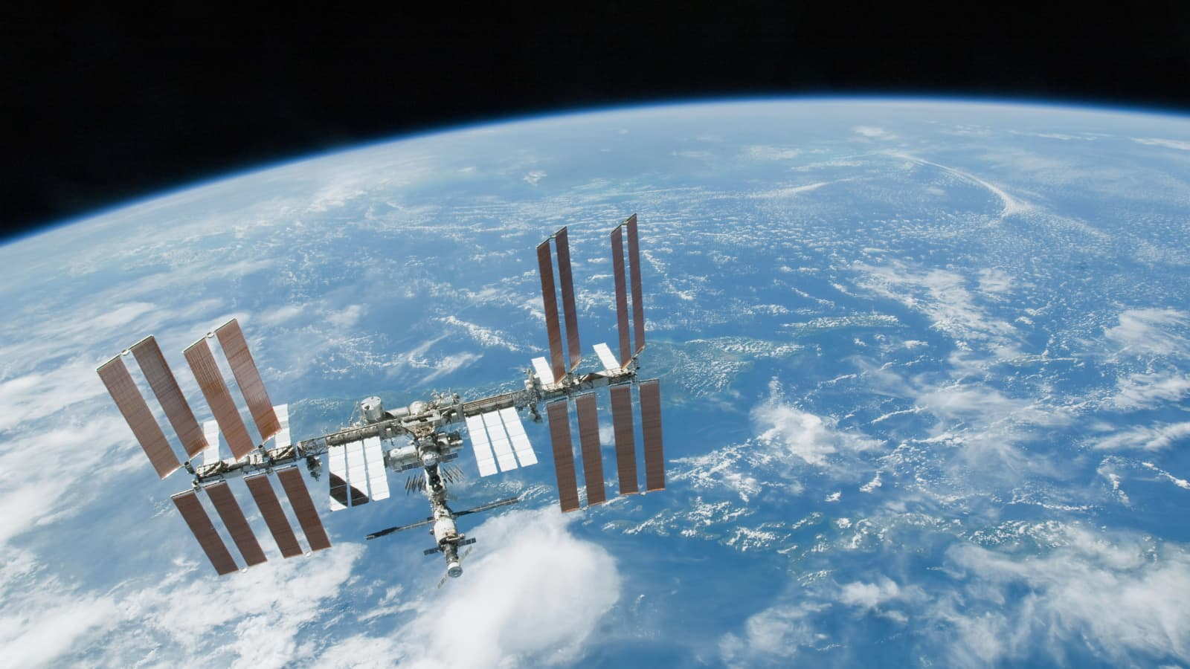
Contents
Introduction
Setup
Contribution
Reaction Wheel Subsystem
Overview
Specifications
Modelling in Simscape
Thruster Subsystem
Overview
Calculation of Thrust
Simulink model

Slide 3
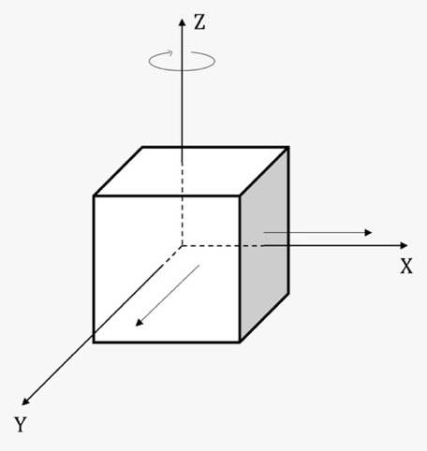
Introduction
A 3 DoF (Degrees of Freedom) system simulates the movement of a Spacecraft in the 2D plane ( 2 translational + 1 rotational).
Especially useful for the study of close proximity operations where accurate spacecraft control is crucial.
By applying a realistic simulation environment, the 3-DoF simulator permits the testing and refinement of procedures/techniques, thereby enhancing the safety/efficiency of space missions.
Fig. Schematic of 3DoF system

Slide 4
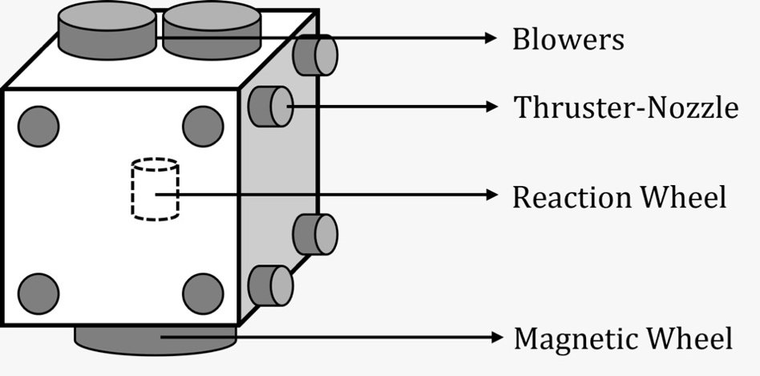
Setup
This setup consists of many subsystems such as Reaction Wheel Subsystem, Thruster Subsystem, Magnetic Levitation Subsystem, etc.
In this presentation, we will look at the Reaction Wheel and Thruster Subsystem and their modelling in detail.
Fig. Schematic of the spacecraft

Slide 5
Contribution
I joined this project in Jan 2023, when it was already ongoing with 5 members.
I was tasked with creating the theoretical model for the Reaction Wheel Subsystem and the Thruster Subsystem.
I created the Reaction Wheel Subsystem in Simscape and the Thruster Subsystem in Simulink.

Slide 6
Reaction wheel subsystem
Voltage
Reaction/momentum wheels - flywheels utilized on spacecraft for attitude control authority and stability.
The spacecraft rotates as energy is added or subtracted to the flywheel, producing a torque.
A model of the reaction wheel subsystem used in the 3 Degrees of Freedom (DOF) spacecraft simulator is created using the Simscape software .
Torque from motor
Angular velocity of flywheel
Angular Momentum of flywheel
Overview of Reaction Wheel Subsystem

Slide 7
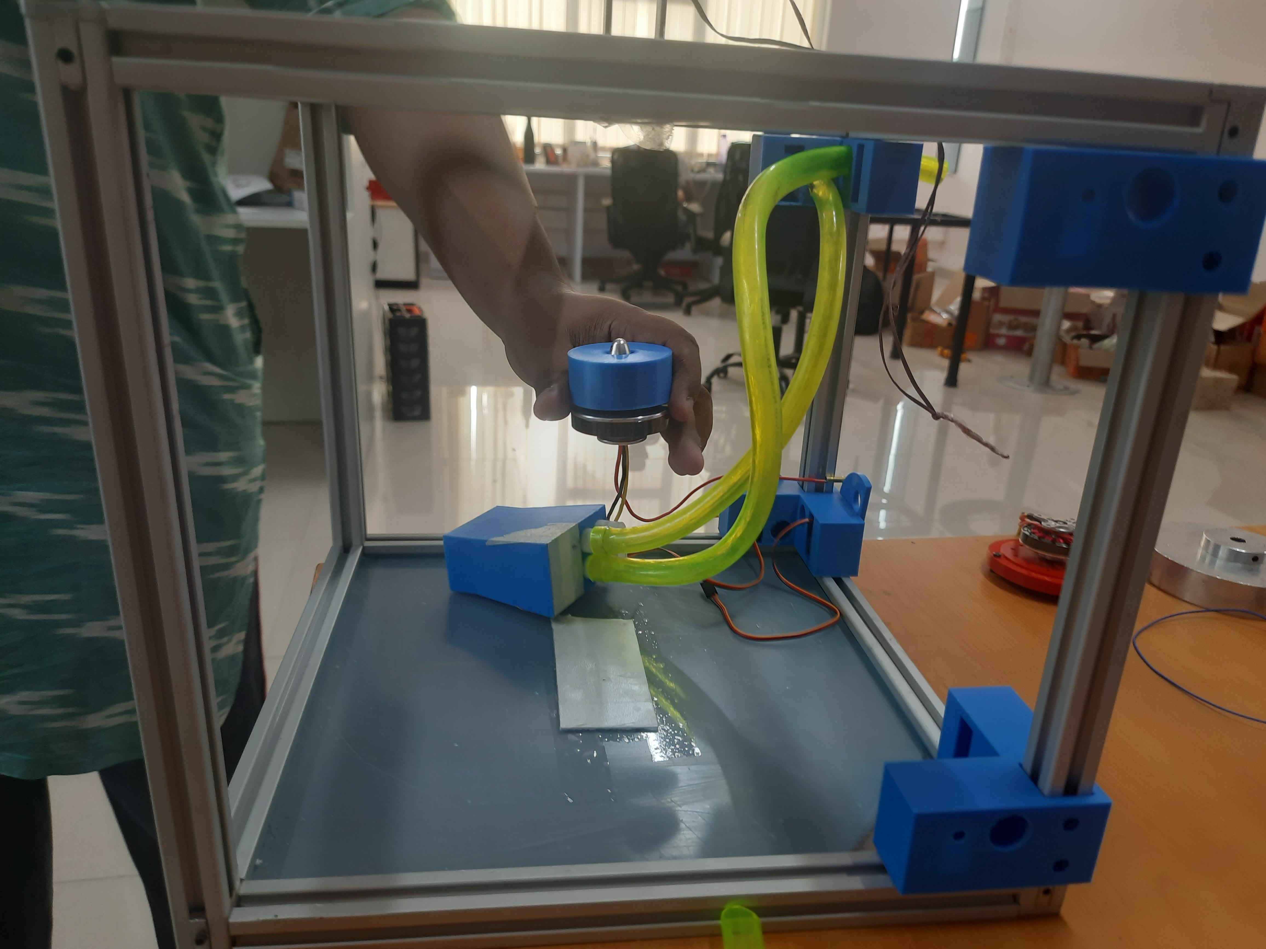
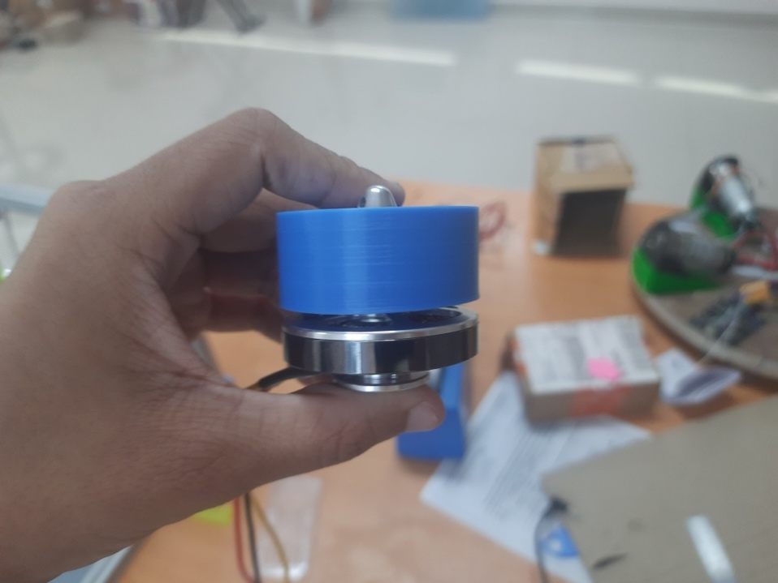
Reaction wheel built using PLA
Fig. Position of reaction wheel in the model
Fig. Reaction wheel attached to motor

Slide 8
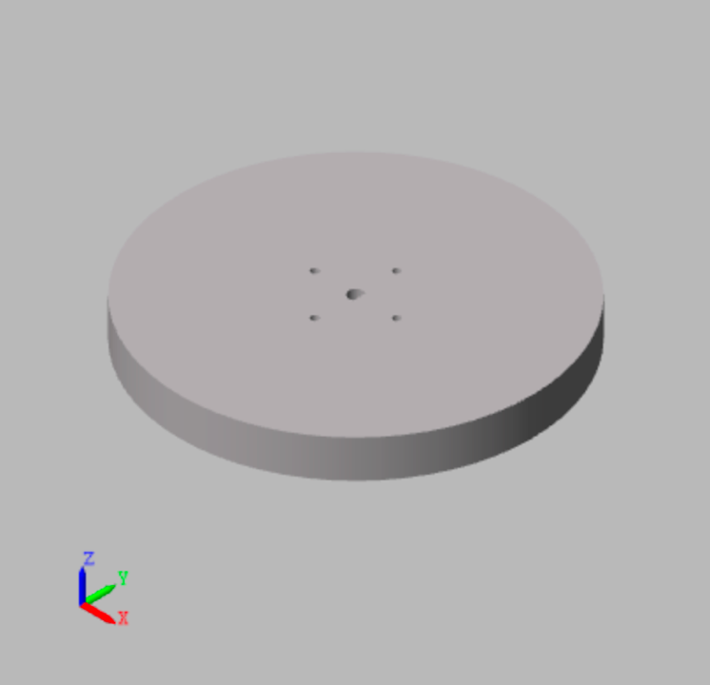
Specifications of flywheel
Material: PLA (Polylactic Acid)
Diameter: 30 cm
Density: 1240 kg/m³
Mass: 0.352 Kg
Center of mass position (WRT origin defined in the CAD model): [1.83709e-07, 1.66408e-06, 0.00803719] m.
Moments of inertia: [0.000502815, 0.000502815, 0.000990484] kg*m²
Products of inertia: [-1.33375e-12, -3.57932e-10, 1.05075e-13] kg*m²
Fig. Flywheel used in the model

Slide 9
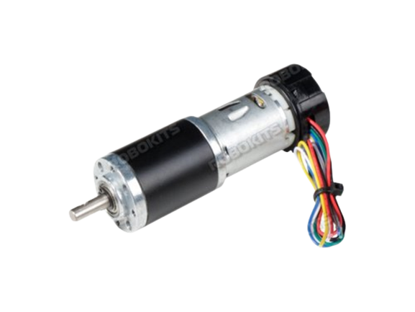
Specifications of DC motor
Model: Rhino Planetary Geared Quad Encoder 500RPM 6Kgcm DC Servo Motor
Operating Voltage: 12V DC
Motor speed at output shaft: 450 RPM
Stall torque: 22Kgcm
Rated Torque: 6Kgcm
Weight: 300gm
Diameter of shaft: 6mm
Fig. DC motor used in the subsystem

Slide 10
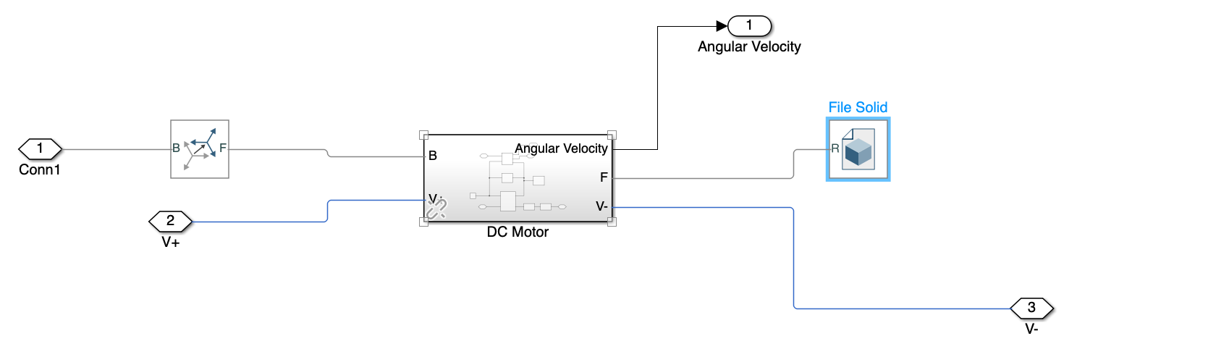
Simscape model of reaction wheel subsystem
Fig. Simscape model of the reaction wheel subsystem

Slide 11
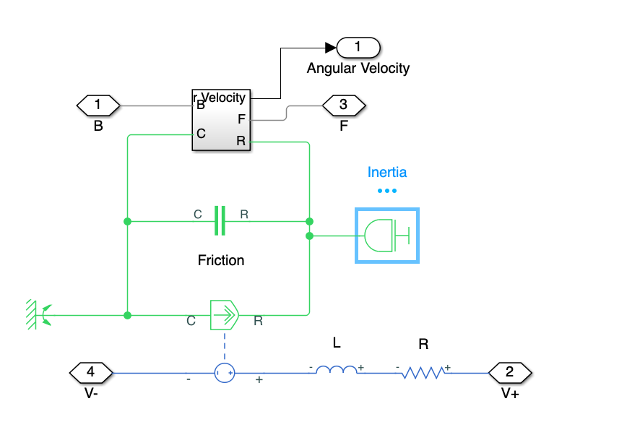
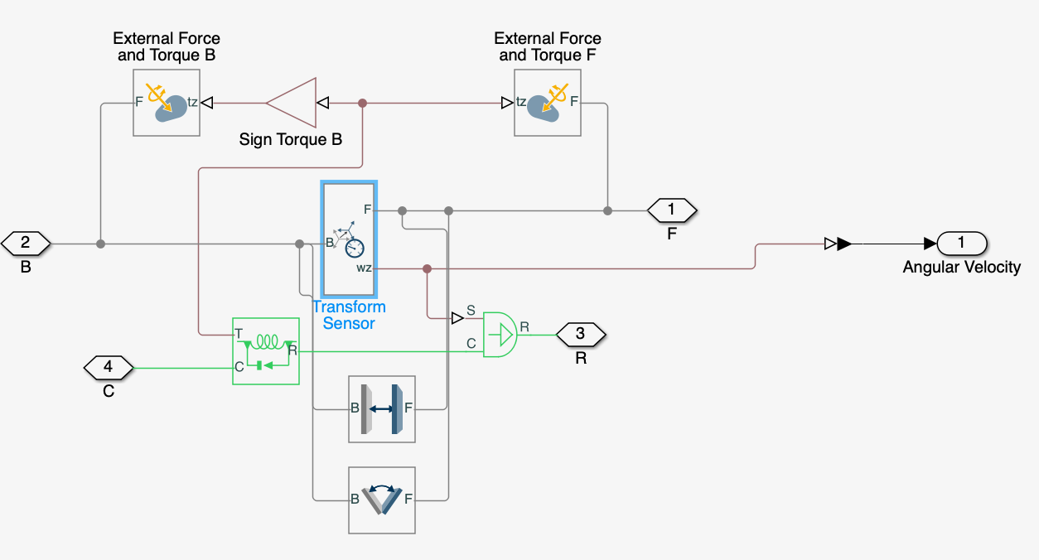
Under the hood…
Fig. DC motor subsystem in Simscape
Fig. Rotational multibody block in DC motor

Slide 12
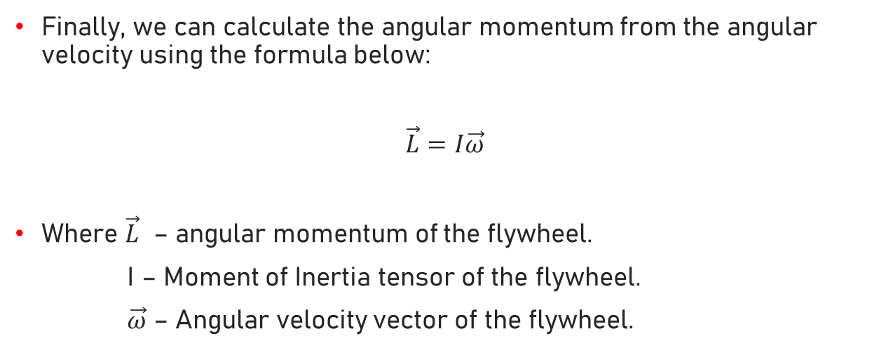
Calculations
Finally, we can calculate the angular momentum from the angular velocity using the formula below:
$\vec{L}=I\vec{ω}$
Where $\vec{L}$ – angular momentum of the flywheel.
I – Moment of Inertia tensor of the flywheel.
$\vec{ω}$ – Angular velocity vector of the flywheel.

Slide 13
Thruster subsystem
The overview of the thruster subsystem is shown as follows:
Inputs: PWM voltage from 12 V DC Battery using Arduino UNO
Outputs: Forces F_{X} and F_{Y}, Moment M_{Z}
Velocity from each nozzle
Voltage
Blower
Velocity
Blower connector
Thruster nozzle
Force from each nozzle
F_{X}
F_{Y}
M_{Z}

Slide 14
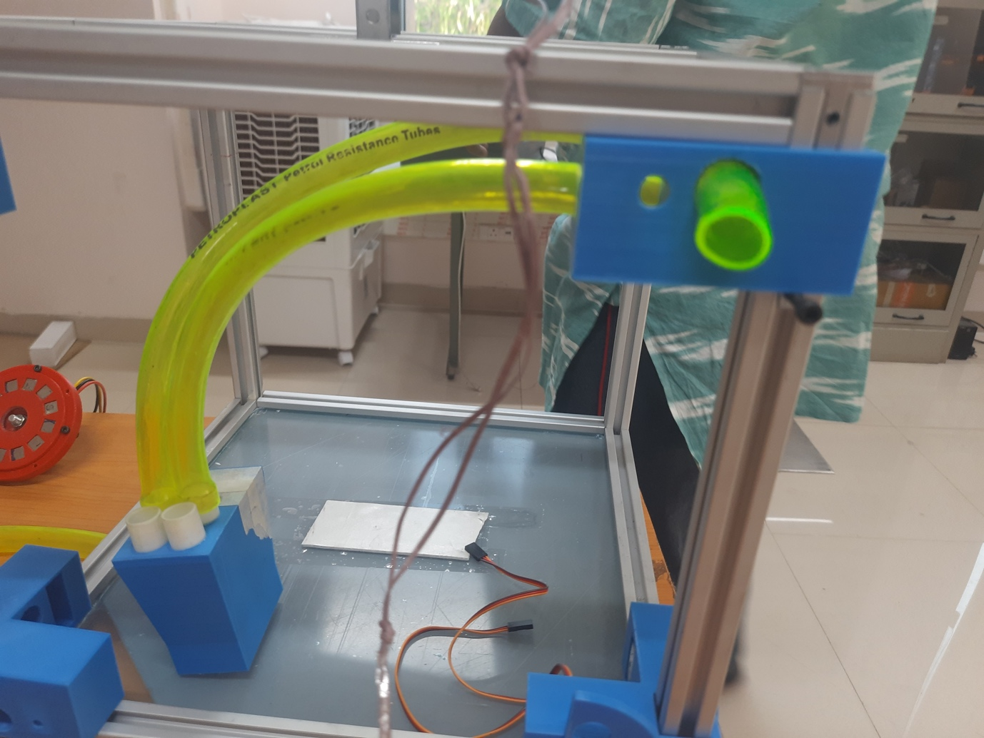
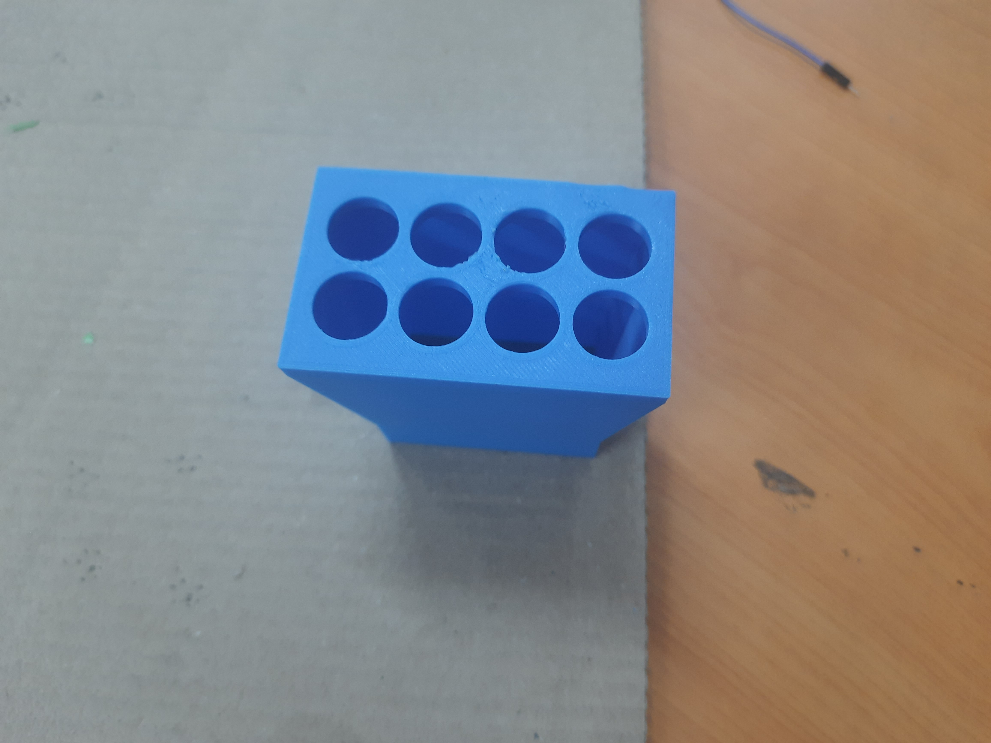
Thruster built in 3Dof simulator
Fig. Relative position of nozzle
Fig. Blower connector

Slide 15
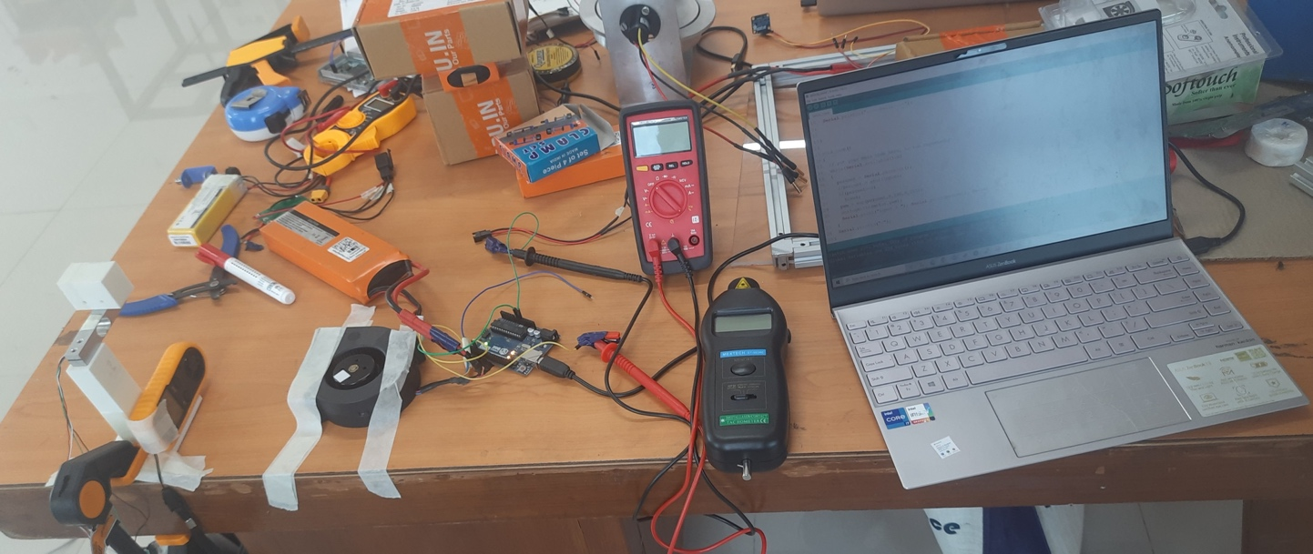
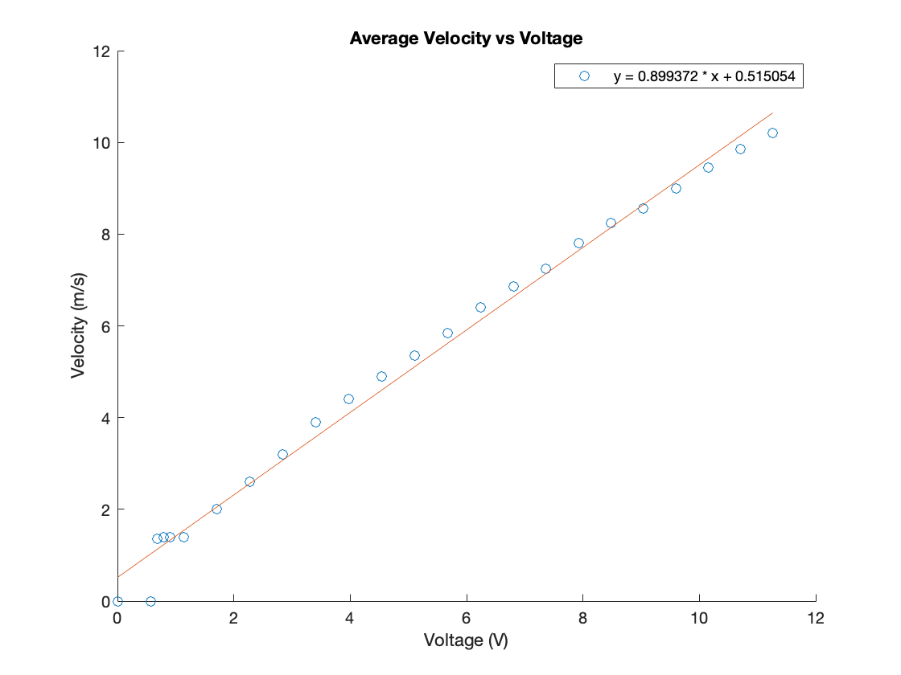
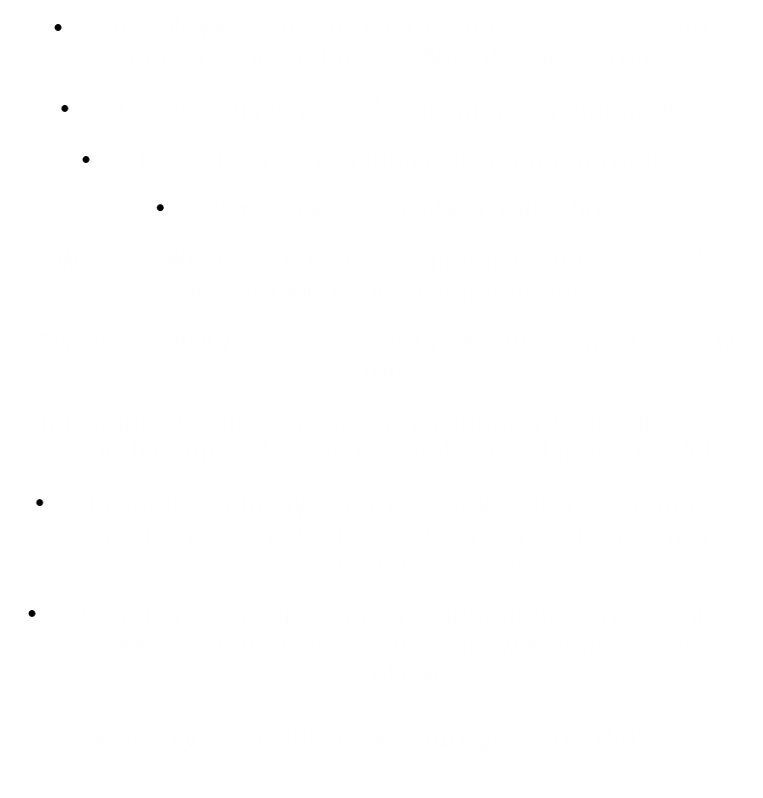
Calculation of thrust
The blowers run on 12V DC supply, and the input voltage is varied using PWM through Arduino.
The velocity is recorded from the anemometer.
The voltage is calculated using the formula:
$Percentage= PWM∗100/256$
Where PWM is an integer ranging from 0 to 255 and percentage varies from 0 to 100
$Average Voltage = (Percentage∗voltage measured)/100$
The velocity values are taken for different voltages and the 1D lookup table thus created is used in the model
From the velocity, the mass flow rate can be found and from the mass flow rate, the thrust force from each nozzle can be found.
Using linear regression and best fit line, the relation between the voltage and velocity was determined as follows
$$Velocity = 0.899372 ∗ Voltage + 0.515054$$
Fig. Experimental Setup for thrust calculation
Fig. Average Voltage vs Velocity

Slide 16
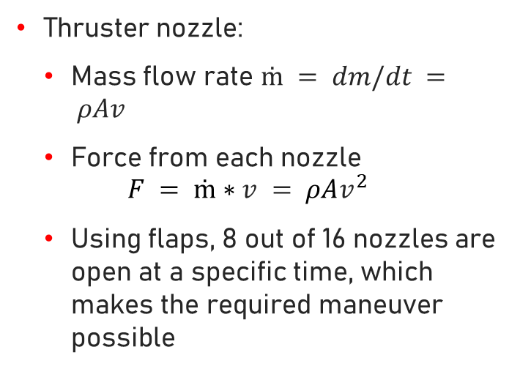
Velocity to thrust
Blower connector:
Divides airflow into 8 parts
Nozzles to be opened are determined based on a logic (matrix) for the required force and torque
Thruster nozzle:
Mass flow rate $ṁ = dm/dt = ρAv$
Force from each nozzle
$$F = ṁ∗v = ρAv^{2}$$
Using flaps, 8 out of 16 nozzles are open at a specific time, which makes the required maneuver possible

Slide 17
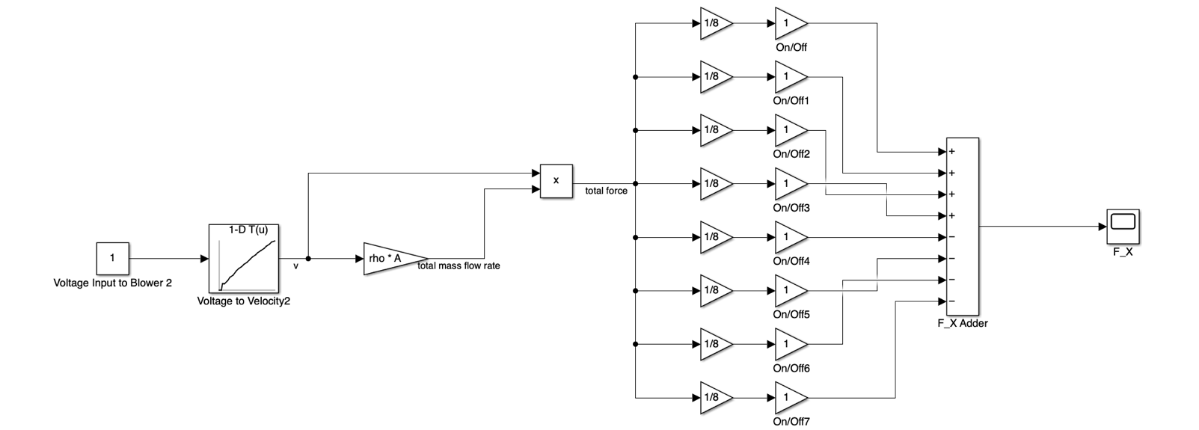
Simulink model of thruster
The relevant logic matrix will be added here

Slide 18

references
https://robokits.co.in/motors/rhino-ig32-12v-20w-dc-motors/dc-servo-encoder-12v-motor/rhino-500rpm-6kgcm-12v-dc-planetary-geared-quad-encoder-servo-motor - For the DC motor used in reaction wheel subsystem

Slide 19
THANK YOU!
Any Questions?

